Slide 1
Analyzing the Network of The ISIS Tweets using Social Network Analysis

Slide 2

Background
Islamic State of Iraq and the Levant known as ISIS one of the terrorist Organizations which is a global threat controls Syria and most of Iraq and Israel.
Analysis of this terrorist network is essential for discovering their propaganda. ISIS has a constant stream of propaganda for which it is using twitter 90% of the time to spread violence.
ISIS consists of 70,000 twitter accounts globally out of which around 200,000 tweets are being posted on twitter every day.
Studying the network of ISIS helps in developing counter strategies in order to blunt its outreach efforts effectively as it is using digital strategy to crowdsource.
Using social network analysis and tools we will be able to explore the complex networks to recognize patterns which were previously unreadable. Through this we will be able to extract the hidden relationships, their strategies and the user interactions.

Slide 3

Research Questions:
Subgroup Detection
Identification of important actors and their roles in the Network
Discovery of the Interactions and Patterns between the actors

Slide 4
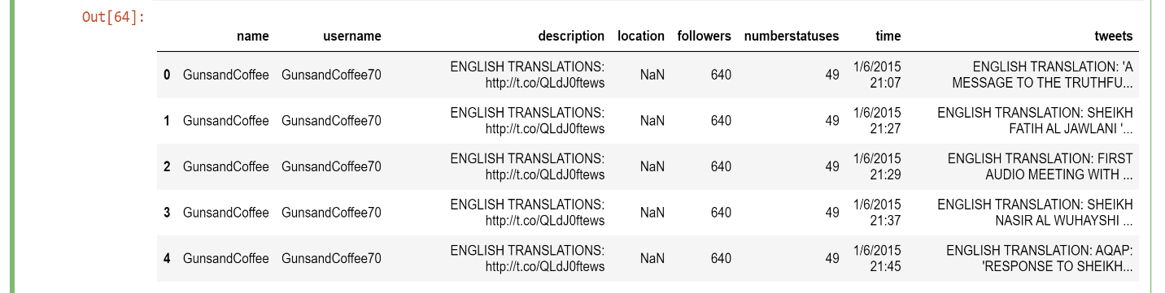
Dataset Collection
Over 17,000 tweets from more than 100 posts of pro-ISIS fanboys from all over the world since the November 2015 Paris Attacks has been scrapped
Sample Dataset :

Slide 5
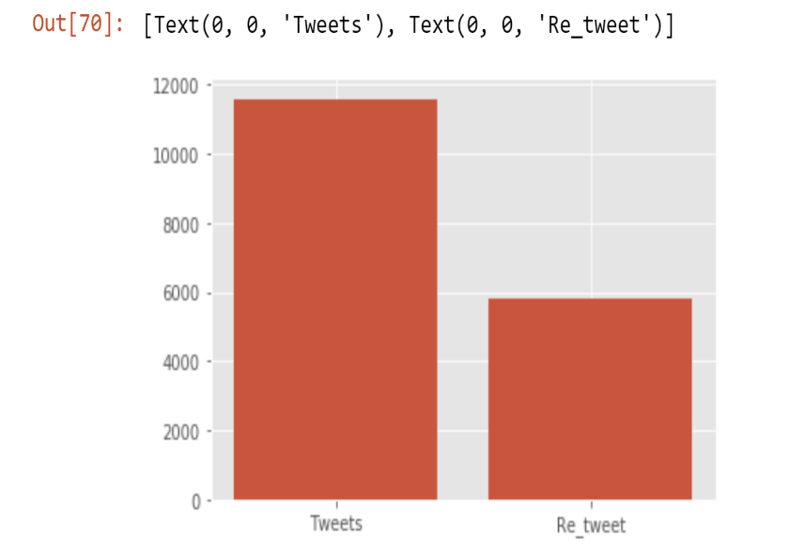
Actual Tweets and Re-tweets:
We can see the plot about the Actual number of tweets which were done vs the tweets which were re-tweeted by the users.

Slide 6
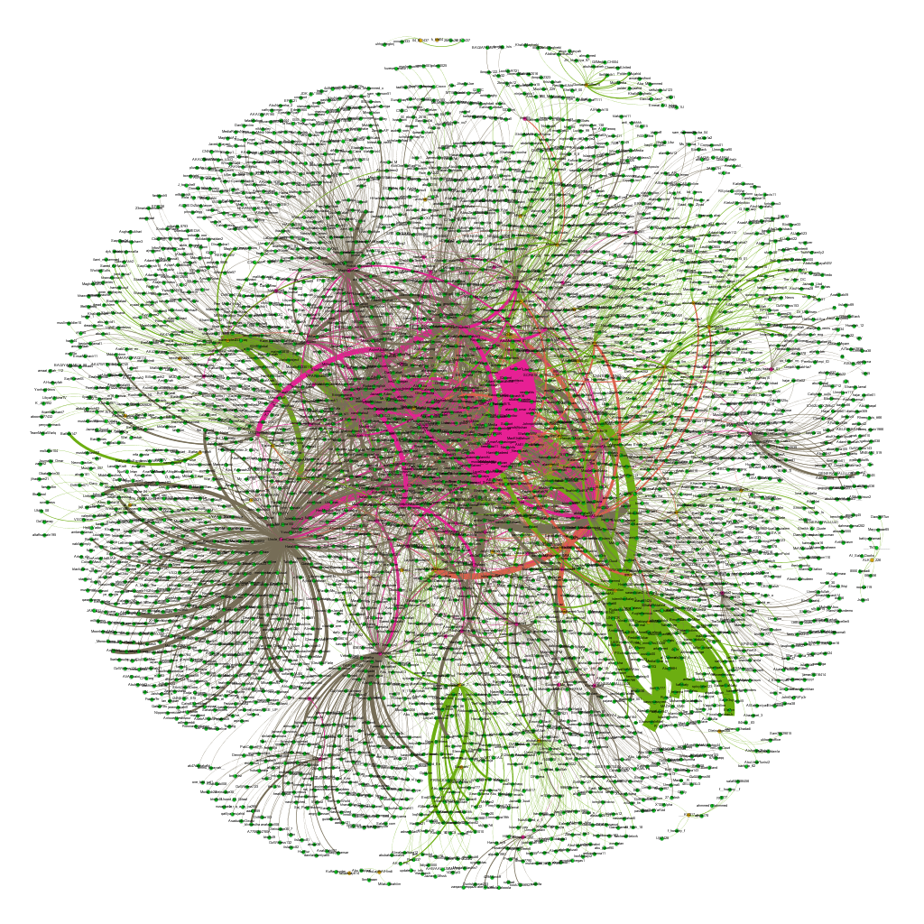
Overview of the Network

Slide 7
Statistics of the Data:

Slide 8
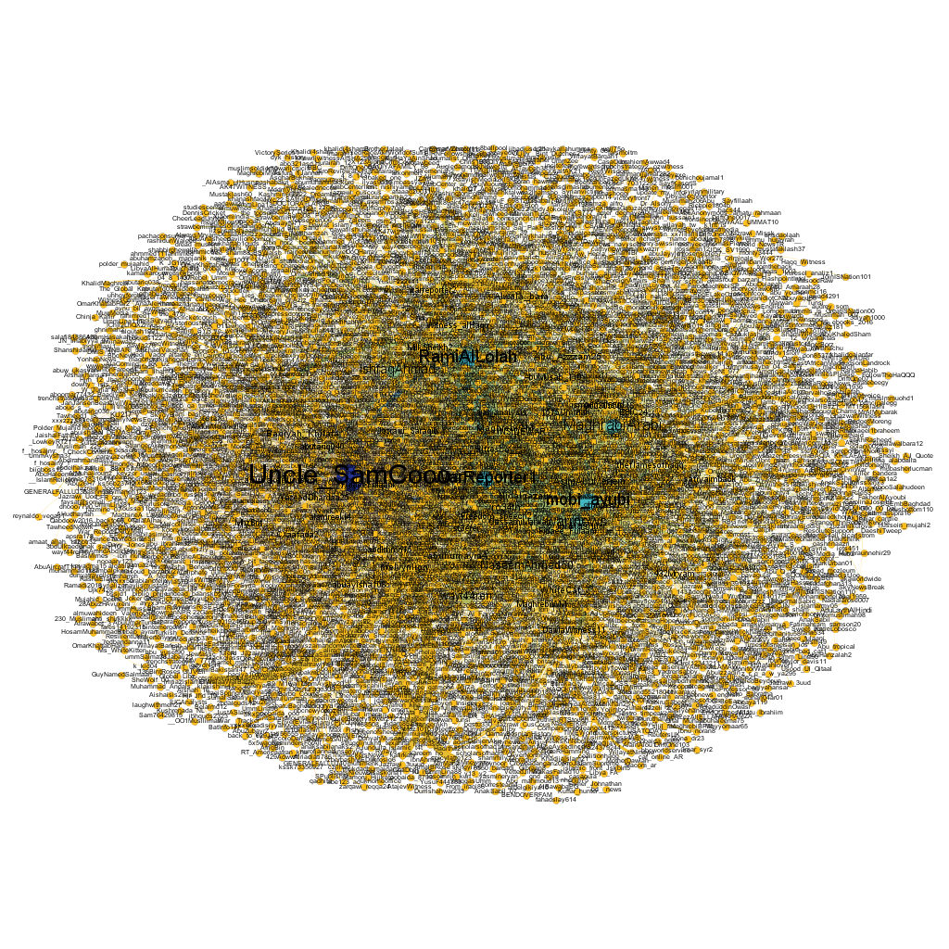
Network of Degree Distribution

Slide 9

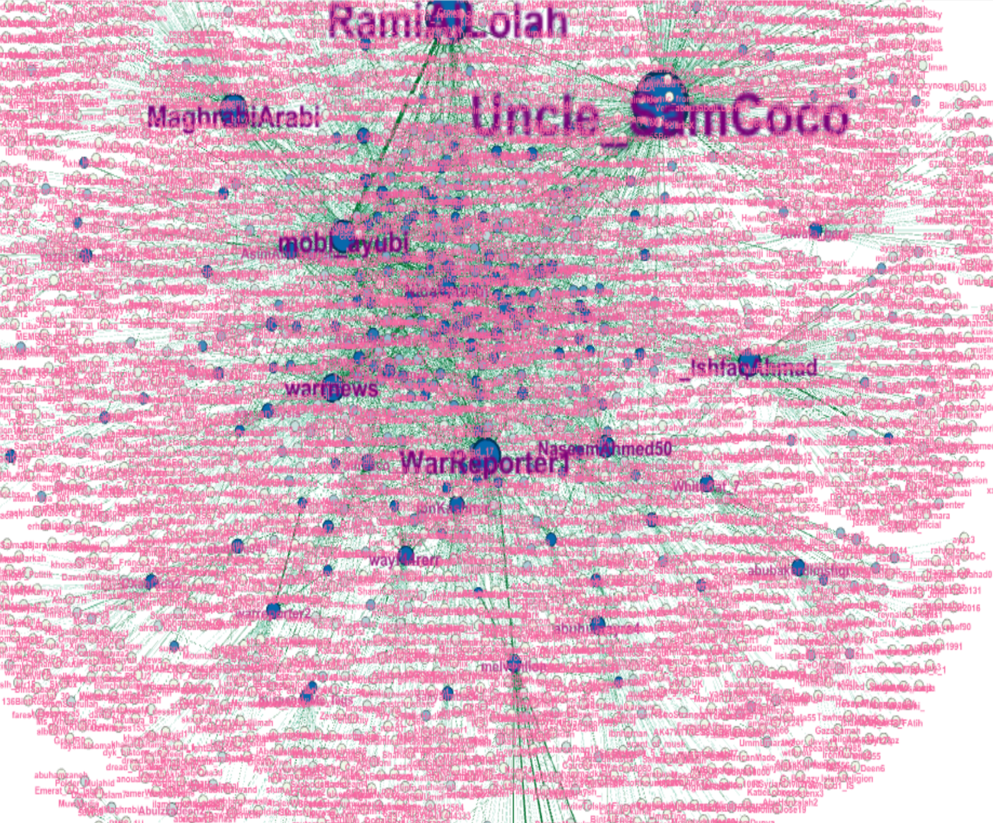
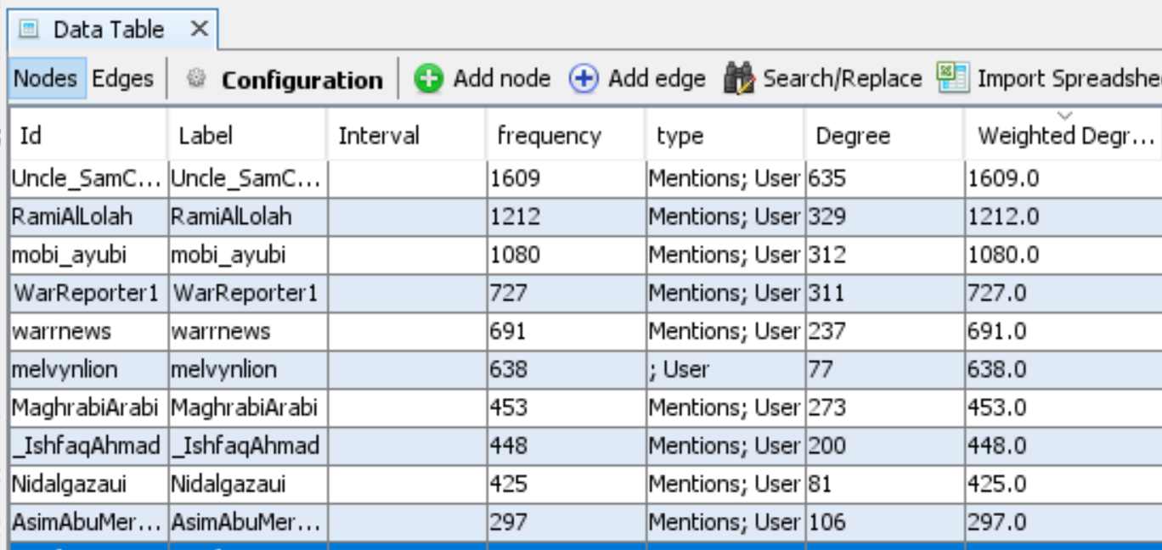
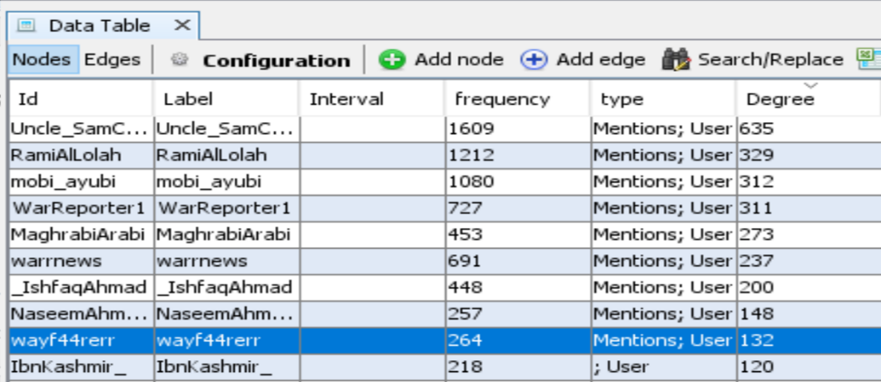
Network of Weighted Degree Distribution

Slide 12
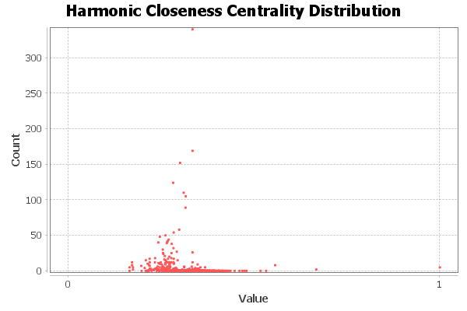
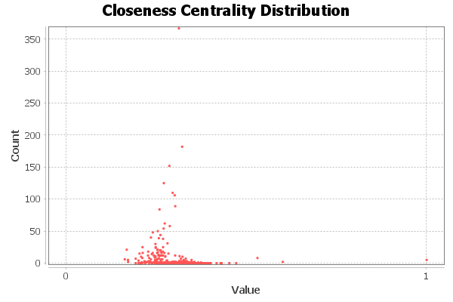
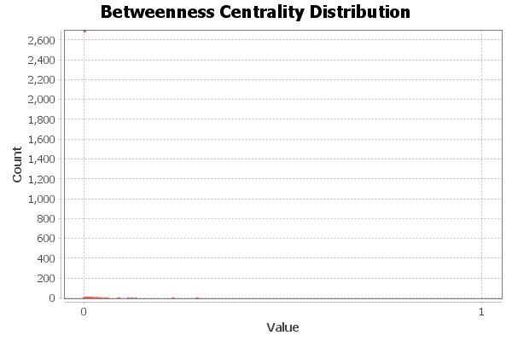
Graph Distance Report
Parameters:
Network Interpretation: undirected
Results:
Diameter: 9 Radius: 1 Average Path length: 3.597765924190278

Slide 14
Betweenness Centrality:

Slide 18
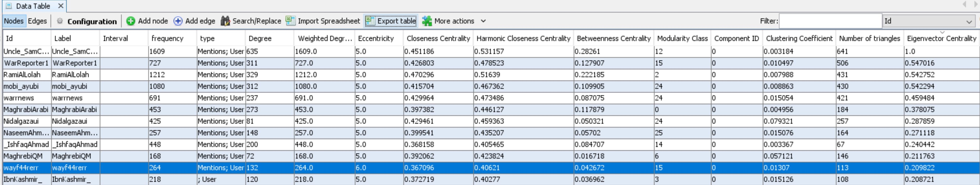

Slide 19
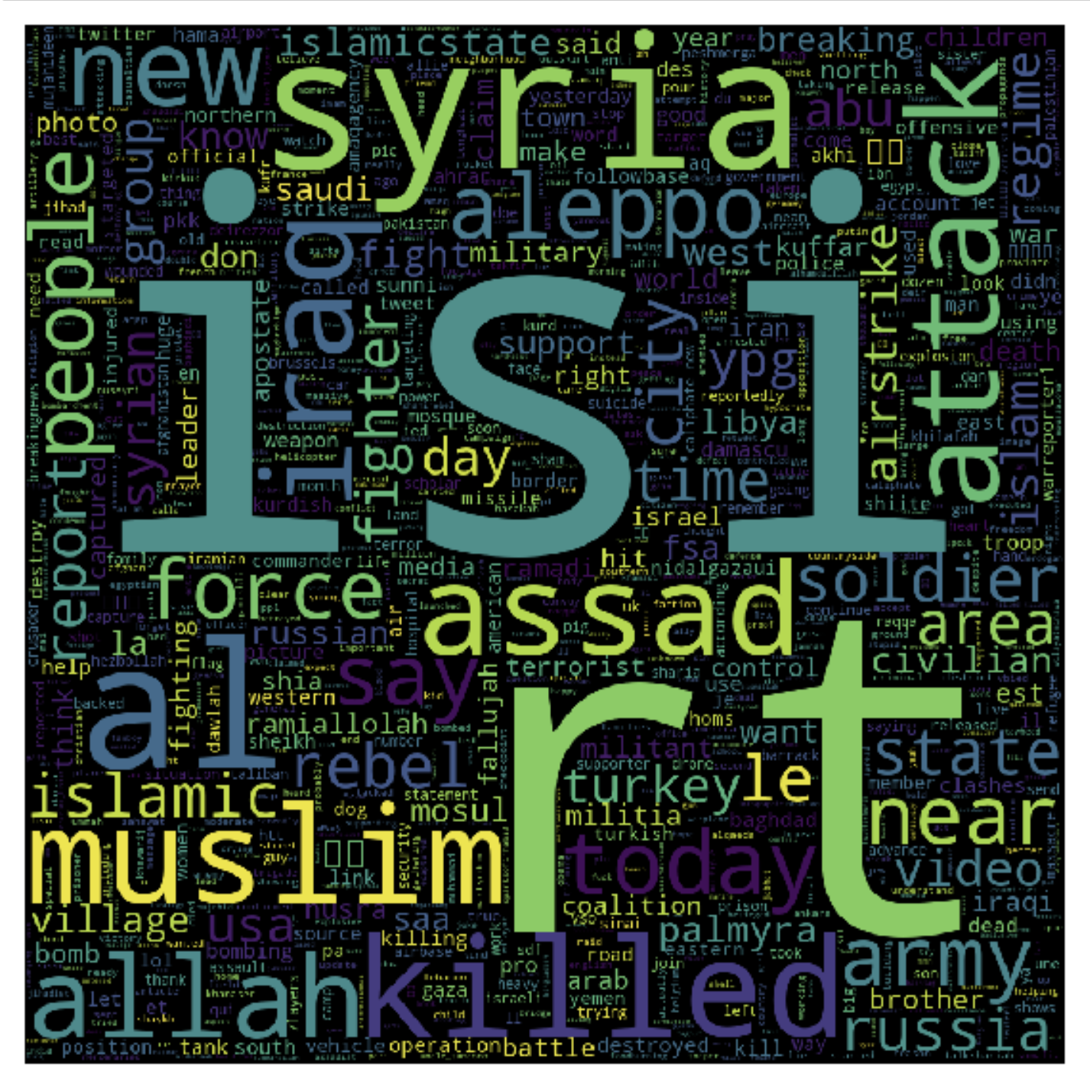
Word Cloud Result:

Slide 20
Conclusion
In the recent years, we have seen frequent reports of terrorist attacks all around the world.
A good understanding of the terrorist organizations and their social networks is helpful to combat the potential terrorist attacks.
In this work, we have utilized Fruchterman and Reingold Algorithm to initialize the coordinates of nodes in terrorist social networks and applied the Degree Centrality, Closeness Centrality, Betweenness Centrality, Eigenvector Centrality, Clustering Coefficient, K-core algorithm for visualizing and exploring the global ISIS network interactively.
The distance between nodes represents the strength of their associations. Combination of these techniques effectively and efficiently support users to extract to identify the key persons in the terrorist groups and discovering specific patterns of interaction among the terrorists.
Future Scope:
More tweets can be scrapped out.
In depth analysis of the network can be done based on tweets and the kind of hashtags that are being used in this.
Analysis of different types/kind of people who follow those users.

Slide 21
Thank you!!!

